Slide 1
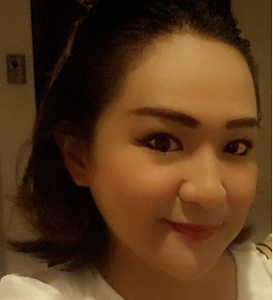
STELLA SETH PANGILINAN
Hand Phone 09260997810
Diploma in Business Administration
Major in Marketing, Advertising and Public relations
Kolej IBMS - Jalan Bukit Mata, Kuching, Sarawak
Malaysia - 2003
BS Computer Science - Graduate 2001
AMA Dasmarinas, Cavite
Goals :
To value , encourage and support a diverse workforce.
To continually improve individual and organizational effectiveness
To champion career and professional growth
To promote honesty, integrity, and trust.
To encourage communication
To embrace change and innovation
To model leadership
To produce quality results
THE HARDEST CHALLENGE BEING HR IS THAT SOMETIMES YOU HAVE
TO BE THE LAWYER, THE JUDGE AND THE HANGMAN.
References are available upon request.

Slide 2
Human Resource/Public Relations Manager
March 2015- February 2018
Bui Gia Astec
Hanoi, Vietnam
Monday to Saturday 2 PM - 9 PM Sunday- On call
Human Resource Manager’s tasks
Public Relations Manager’s tasks
Recruits, screens, interviews and places workers.
Manages overall provision of human resources services, policies and programs for the entire organization.
Analyzes wage and salary reports and data to determine competitive compensational plan.
Identifies legal requirements and government reporting regulations and ensures policies, procedures and reporting are in compliance.
Advises management in appropriate resolution of employee related issues
Plans, develops and implements PR strategies.
Manages enquiries from media, individuals and other organizations.
Plans publicity strategies and campaigns
Organizes events including press conferences, exhibitions and press tours.
Speaks publicly at interviews, press conferences and presentations.

Slide 3
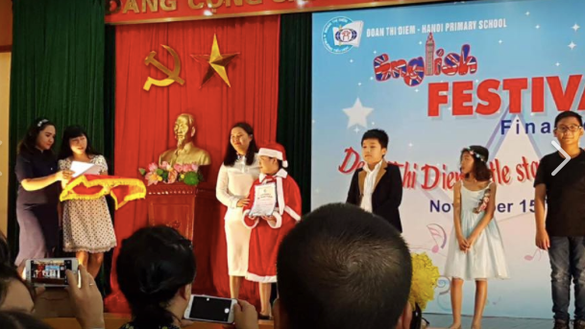
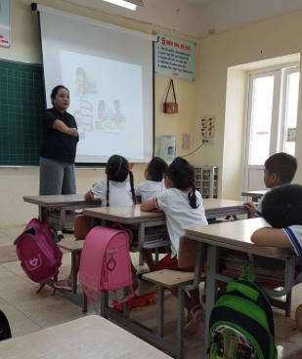
Language Specialist- English/Science Teacher
2009-2018
Doan Thi Diem Private School Hanoi Vietnam
2012-2018 Full Time with Flexible schedule (8-12) Monday- Saturday
Taught English and Science for primary students

Slide 4
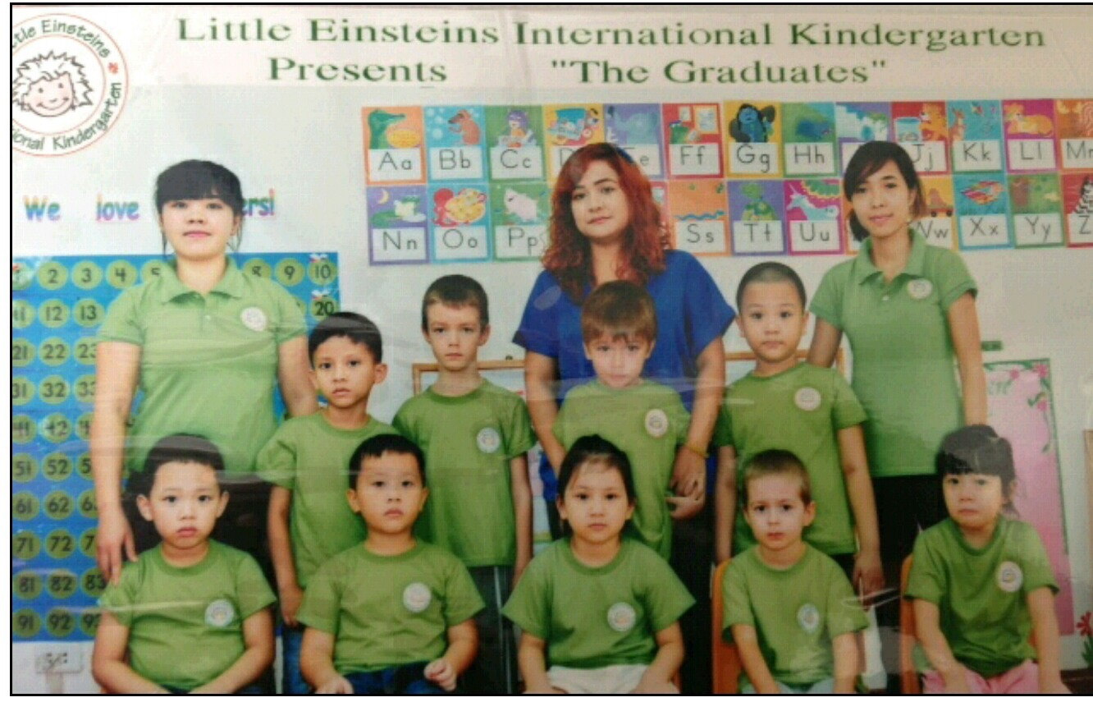
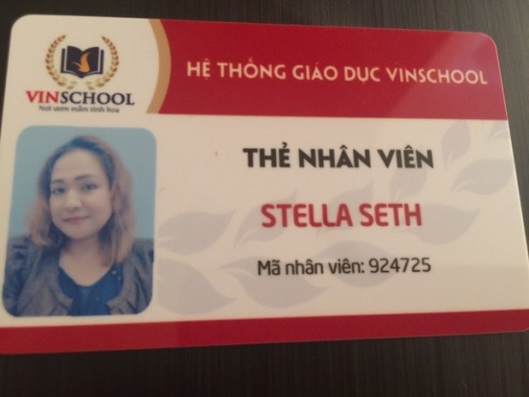
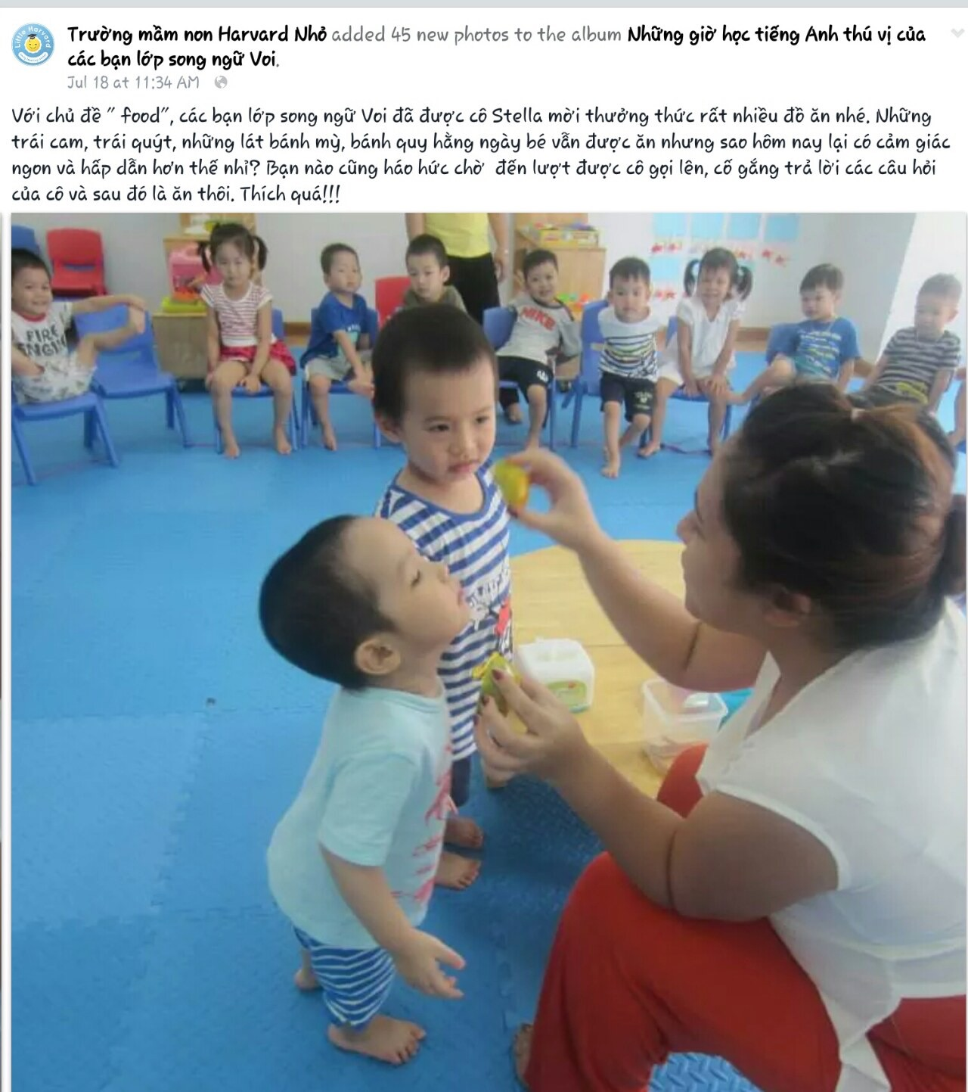
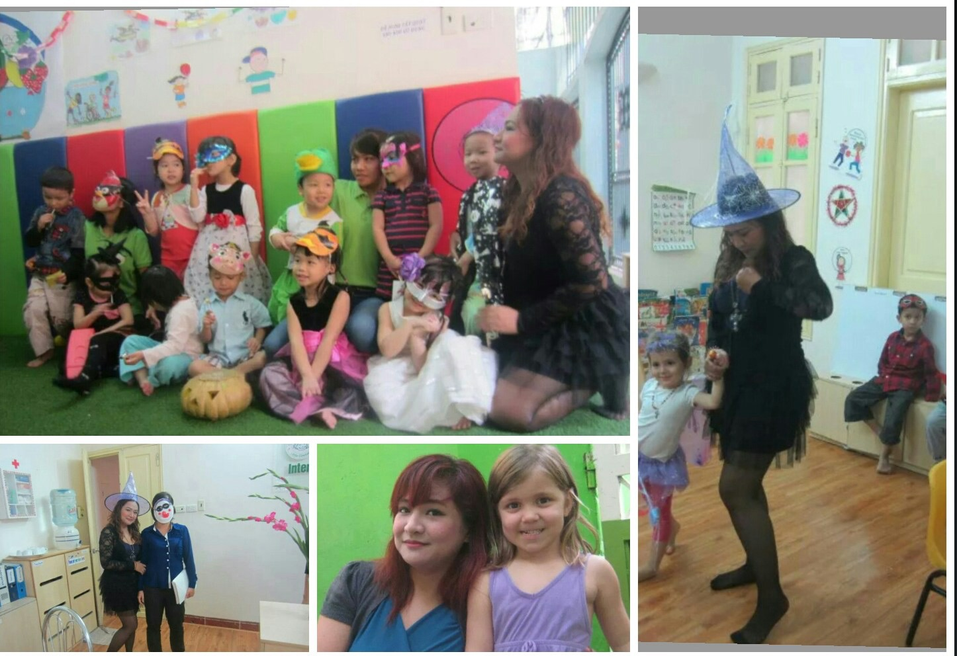
Other Schools
LITTLE EINSTEINS
INTERNATIONAL SCHOOL
VINSCHOOL
LITTLE HARVARD SCHOOL
American School

Slide 5
Denso Corporation - (Japanese company
HANOI )
Taught Foundation English and IELTS
2012
Did IELTS Training in Different Language Training
centers in Hanoi
Call Centers 2005-2009
American Express - Foundation Trainer
Sirius Satellite Radio - Foundation Trainer
Logicall - Medical Financial Specialist
SBR Import Export Specialists 2001-2003
(Came back in 2004 after my Diploma Course in
Malaysia)
Executive Assistant to the Vice President
Worked at Bureau of Customs as part of my job as
an Executive assistant to the Vice President of SBR

